Slide 1
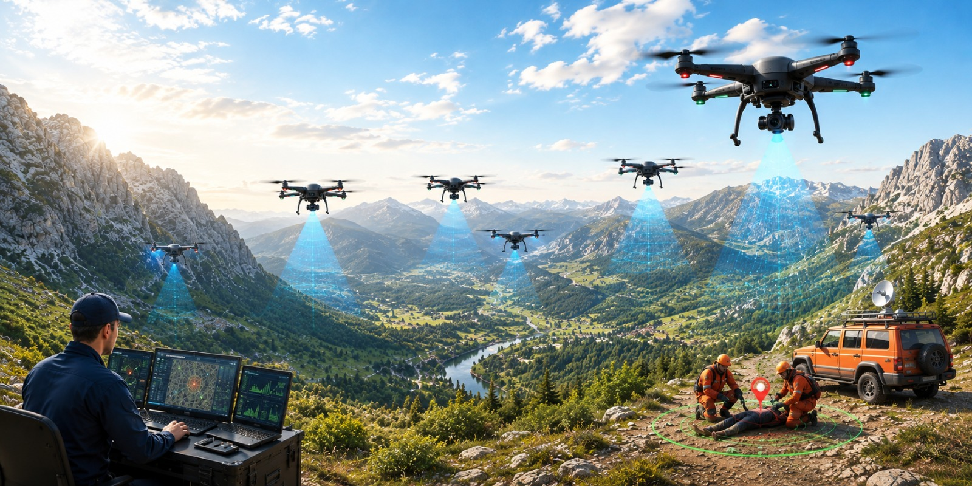
MLA0305-Reinforcement learning
MS1 Jul-Sep 2026 - SLOT B
Cooperative Drone Swarm Search and Rescue using Multi-Agent Reinforcement Learning and Swarm-Based Agent Simulation
Guided by, Dr. Vincent Gnanaraj T
Associate Professor
Department of Quantum Intelligence
SIMATS Engineering
Presented by, 192425196-P.Hithaishi
192472216-K.Sri Lasya
192525322-N.Parnita

Slide 2
Abstract
Cooperative Drone Swarm Search and Rescue using Multi-Agent Reinforcement Learning and Swarm-Based Agent Simulation proposes an intelligent drone swarm for autonomous search and rescue operations. Traditional search methods and single-drone systems suffer from limited coverage, poor coordination, and increased search time. The proposed system integrates Multi-Agent Reinforcement Learning (MARL) with swarm-based agent simulation to enable cooperative decision-making among multiple drones. The drones communicate, coordinate, and optimize their search paths to improve overall mission performance while minimizing redundant exploration. Compared with existing approaches, the proposed framework provides faster target detection, wider area coverage, improved scalability, and enhanced operational efficiency. Simulation results demonstrate better coordination, reduced search time, and higher mission success rates.

Slide 3
Introduction
Cooperative Drone Swarm Search and Rescue using Multi-Agent Reinforcement Learning and Swarm-Based Agent Simulation is an intelligent system that uses multiple autonomous drones to perform efficient search and rescue operations.
Multi-Agent Reinforcement Learning (MARL) is an AI technique in which multiple agents learn collaboratively and make intelligent decisions to achieve a common objective.
Swarm-Based Agent Simulation enables drones to coordinate, communicate, and perform tasks collectively without requiring centralized control.
The proposed system integrates MARL with swarm intelligence to enable autonomous navigation, cooperative search, and efficient task allocation among multiple drones.
Each drone shares real-time information with other drones to maximize search coverage, avoid redundant exploration, and improve overall mission performance.
Compared with conventional search methods and single-drone systems, the proposed framework provides faster target detection, better coordination, higher scalability, and improved operational efficiency.

Slide 4
Literature Survey
Author(s), Year, Journal/Proceedings | Title | Key Findings
Hickling, T., Hogan, M., Tammam, A., & Aouf, N., 2026, Journal of Field Robotics | Deep Reinforcement Learning Based Autonomous Decision-Making for Cooperative Uncrewed Aerial Vehicles: A Search and Rescue Real World Application | Developed a deep reinforcement learning framework for cooperative UAVs capable of autonomous navigation, task allocation, and victim search in real-world search-and-rescue missions.
Chen, C., Yan, S., Zhou, X., et al., 2026, Discover Robotics | Multi-stage Hierarchical Multi-Agent Reinforcement Learning for UAV-Quadruped Completing Search and Rescue | Proposed a hierarchical MARL architecture that enables UAVs and ground robots to cooperate efficiently during search-and-rescue operations with improved coordination and exploration.
Liu, M., Wei, J., & Liu, K., 2024, Drones | A Two-Stage Target Search and Tracking Method for UAV Based on Deep Reinforcement Learning | Introduced a two-stage reinforcement learning model for target search and tracking that improved navigation accuracy and target-following performance.
Sadhu, V., Sun, C., Karimian, A., Tron, R., & Pompili, D., (2024) IEEE Conference Proceedings | Aerial-Deep Search: Distributed Multi-Agent Deep Reinforcement Learning for Search Missions | Presented a distributed deep reinforcement learning framework allowing multiple UAVs to cooperate efficiently while exploring unknown environments.
Han, S., Liu, X., Zhou, M. C., et al., 2024, IEEE Internet of Things Journal | Joint Association, Deployment and Flight Trajectory Optimization for Multi-UAV Enabled Large-Scale Mobile Edge Computing | Proposed optimized UAV deployment and trajectory planning to improve communication efficiency and cooperative mission performance.

Slide 5
Literature Survey
Author(s), Year, Journal/Proceedings | Title | Key Findings
Chung, S. J., Paranjape, A. A., Dames, P., Shen, S., & Kumar, V., 2018, IEEE Robotics and Automation Magazine | A Survey on Aerial Swarm Robotics | Reviewed aerial swarm architectures, autonomous coordination, distributed control, communication methods, and future applications of UAV swarms.
Gupta, L., Jain, R., & Vaszkun, G., 2016, IEEE Access | Survey of Important Issues in UAV Communication Networks | Reviewed UAV communication technologies, swarm networking, coordination strategies, and challenges for autonomous multi-UAV systems.
Dorigo, M., Birattari, M., & Brambilla, M., 2014, Swarm Intelligence | Swarm Robotics | Explained swarm intelligence principles, decentralized coordination, collective decision-making, and cooperative behavior for multi-robot systems.
Yang, L., et al., 2014, Chinese Journal of Aeronautics | A LODBO Algorithm for Multi-UAV Search and Rescue Path Planning | Proposed an optimized path-planning algorithm that reduced travel distance and improved cooperative search efficiency for multiple UAVs.
Cao, Y. U., Fukunaga, A. S., & Kahng, A. B., 1997, Autonomous Robots | Cooperative Mobile Robotics: Antecedents and Directions | Discussed cooperative robot architectures, task allocation, distributed control, and collaboration strategies that form the basis of modern multi-agent robotic systems.

Slide 6
Problem Statement
Existing search and rescue systems and single-drone approaches suffer from limited coverage, inefficient coordination, and increased search time, reducing the overall effectiveness of rescue missions.
There is a need for an intelligent cooperative drone swarm system using Multi-Agent Reinforcement Learning and swarm-based agent simulation to improve coordination, maximize search coverage, optimize path planning, and enhance search and rescue efficiency.

Slide 7
Objectives
To develop a cooperative drone swarm system using Multi-Agent Reinforcement Learning (MARL) for autonomous search and rescue operations.
To implement swarm-based coordination for efficient communication, task allocation, path planning, and maximum search area coverage among multiple drones.
To improve target detection accuracy, reduce search time, and enhance the overall efficiency and reliability of cooperative drone swarm missions.

Slide 8
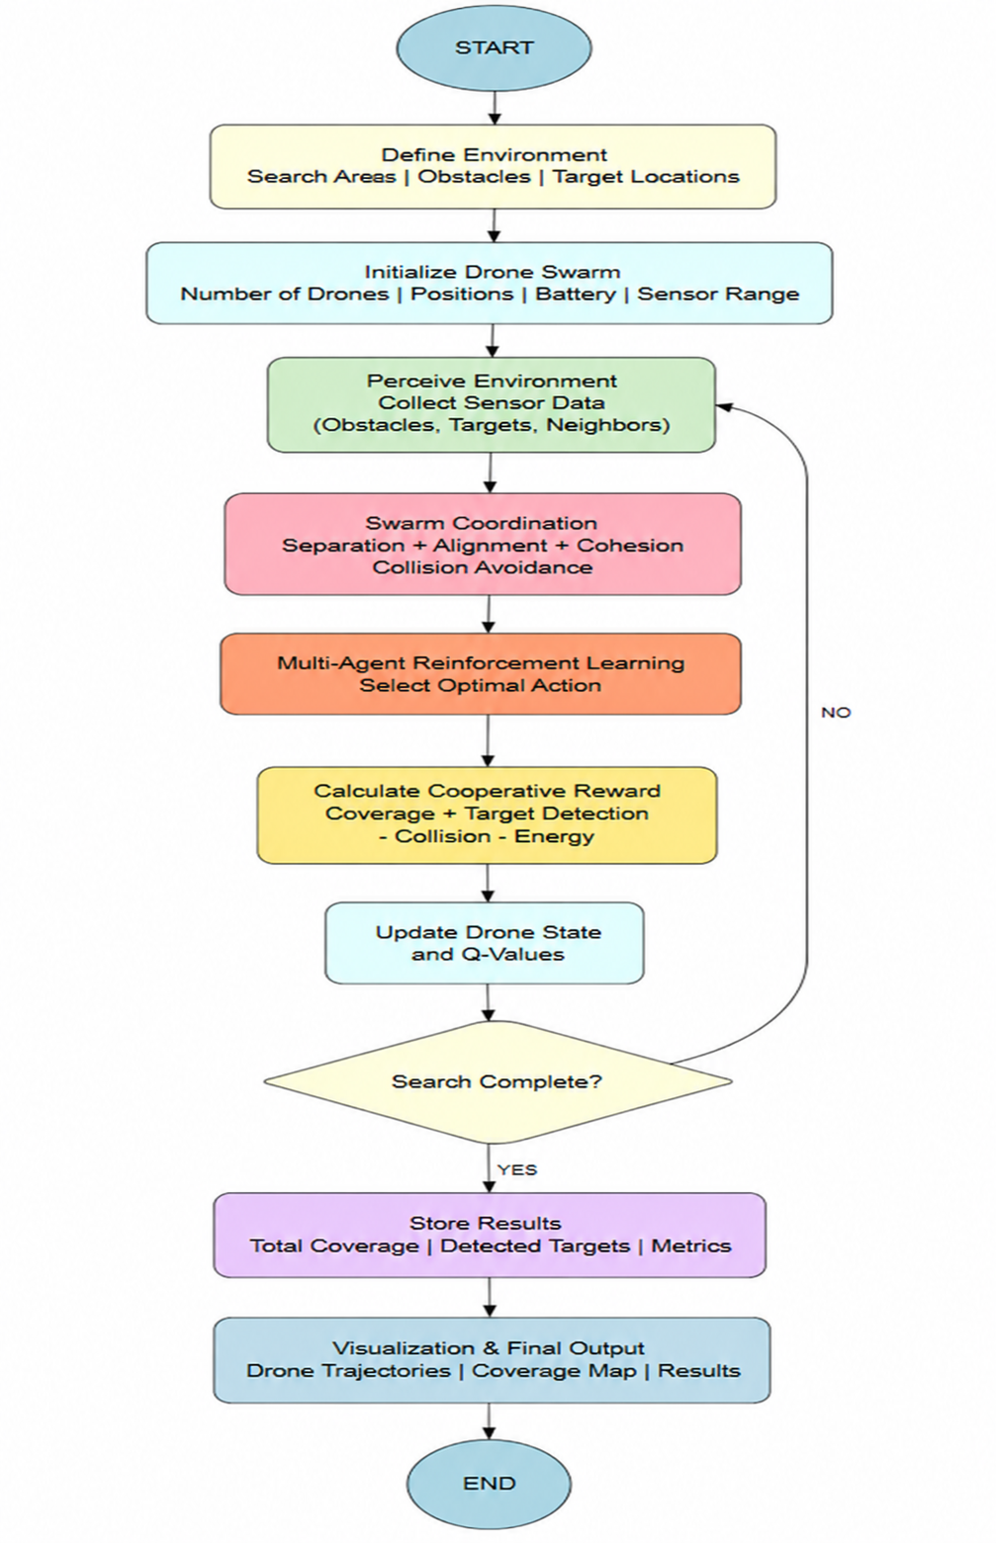
Methodology
Define Environment – Set the search area, obstacles, and target locations.
Initialize Drone Swarm – Set drone number, positions, battery, and sensor range.
Swarm Coordination & MARL – Coordinate drones and select optimal actions.
Reward & State Update – Calculate rewards and update drone states and Q-values.
Search & Output – Repeat until completion, then display trajectories, coverage map, and results.

Slide 9
Methodology
Proposed Algorithm for Cooperative Drone Swarm
Step 1: Define Environment and Drone Swarm
Let
E = Search Environment
D={D1​,D2​,...,Dn​} = Set of Drones
T={T1​,T2​,...,Tm​} = Target Locations
O = Obstacles
Bi​ = Battery level of drone Di​
Ri​ = Sensor range of drone Di​
The environment consists of a predefined search area containing obstacles and unknown target locations.

Slide 10
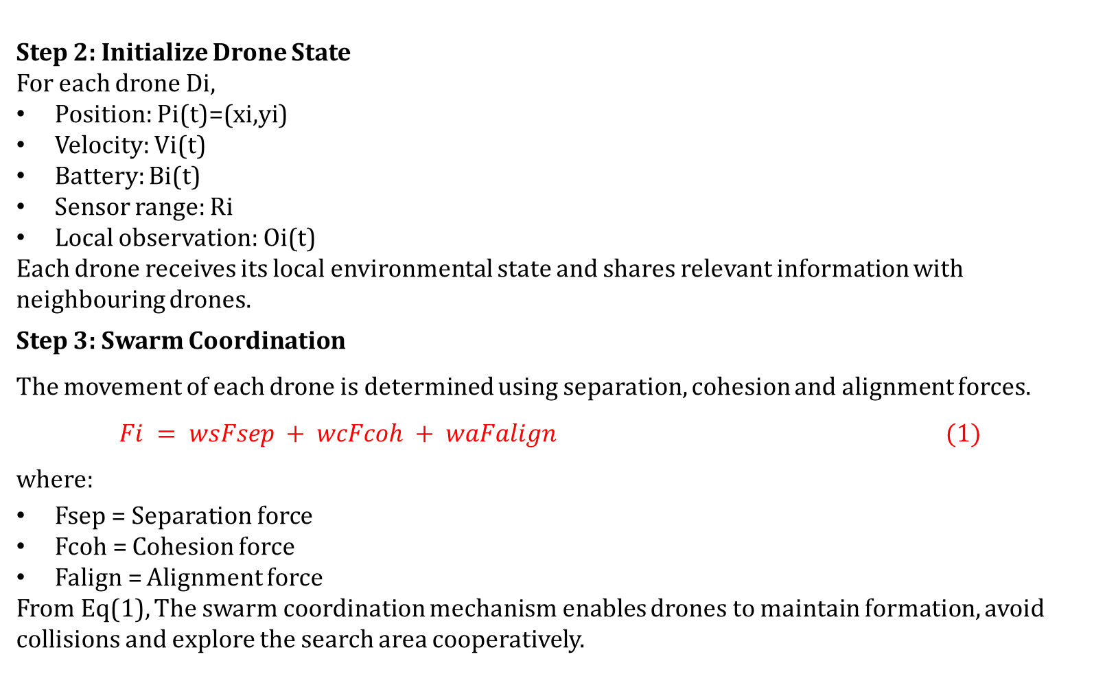
Methodology
Step 2: Initialize Drone State
For each drone Di​,
Position: Pi​(t)=(xi​,yi​)
Velocity: Vi​(t)
Battery: Bi​(t)
Sensor range: Ri​
Local observation: Oi​(t)
Each drone receives its local environmental state and shares relevant information with neighbouring drones.
Step 3: Swarm Coordination
The movement of each drone is determined using separation, cohesion and alignment forces.
$$Fi = wsFsep + wcFcoh + waFalign (1)$$
where:
Fsep​ = Separation force
Fcoh​ = Cohesion force
Falign​ = Alignment force
From Eq(1), The swarm coordination mechanism enables drones to maintain formation, avoid collisions and explore the search area cooperatively.

Slide 11
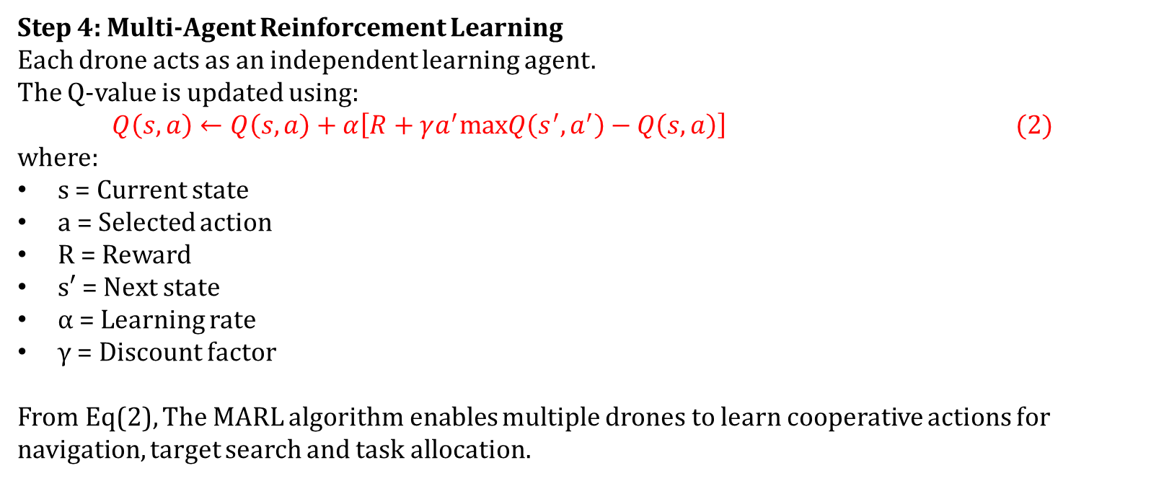
Methodology
Step 4: Multi-Agent Reinforcement Learning
Each drone acts as an independent learning agent.
The Q-value is updated using:
$$Q\left(s,a\right)←Q\left(s,a\right)+α\left[R+γa^{′}max​Q\left(s^{′},a^{′}\right)−Q\left(s,a\right)\right] (2)$$
where:
s = Current state
a = Selected action
R = Reward
s′ = Next state
α = Learning rate
γ = Discount factor
From Eq(2), The MARL algorithm enables multiple drones to learn cooperative actions for navigation, target search and task allocation.

Slide 12
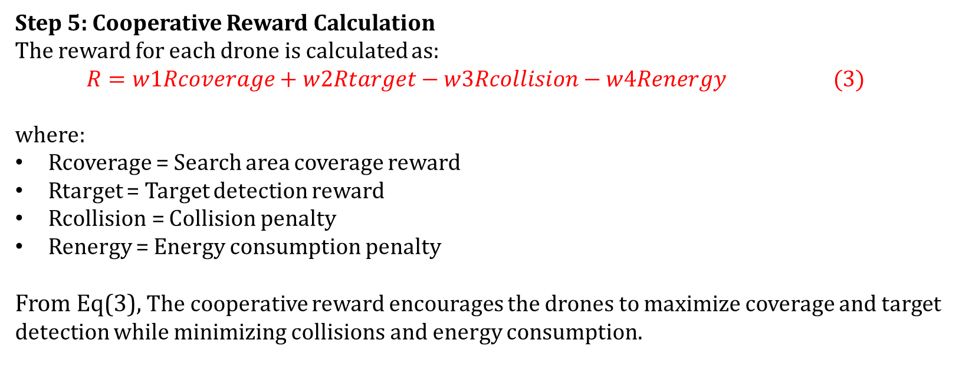
Methodology
Step 5: Cooperative Reward Calculation
The reward for each drone is calculated as:
$$R=w1​Rcoverage​+w2​Rtarget​−w3​Rcollision​−w4​Renergy​ (3)$$
where:
Rcoverage​ = Search area coverage reward
Rtarget​ = Target detection reward
Rcollision​ = Collision penalty
Renergy​ = Energy consumption penalty
From Eq(3), The cooperative reward encourages the drones to maximize coverage and target detection while minimizing collisions and energy consumption.

Slide 13
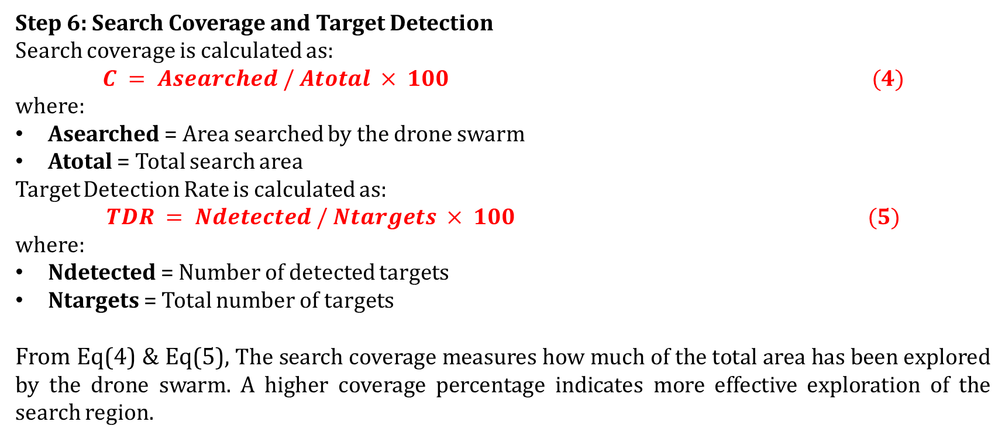
Methodology
Step 6: Search Coverage and Target Detection
Search coverage is calculated as:
$$C = Asearched / Atotal × 100 (4)$$
where:
Asearched = Area searched by the drone swarm
Atotal = Total search area
Target Detection Rate is calculated as:
$$TDR = Ndetected / Ntargets × 100 (5)$$
where:
Ndetected = Number of detected targets
Ntargets = Total number of targets
From Eq(4) & Eq(5), The search coverage measures how much of the total area has been explored by the drone swarm. A higher coverage percentage indicates more effective exploration of the search region.

Slide 14
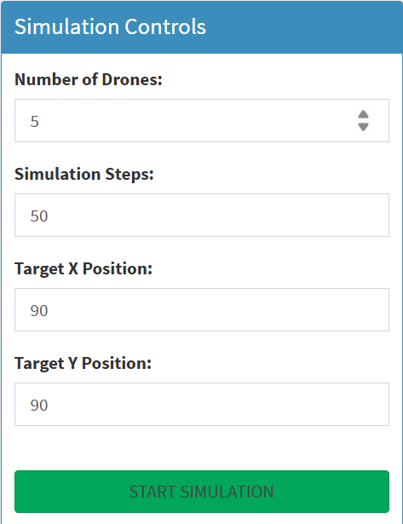
MODULE 1 – Environment & Drone Initialization
Define the search environment with the required search area, obstacles, and target locations.
Initialize the drone swarm with a predefined number of drones.
Set the initial position, velocity, battery level, and sensor range of each drone.
Each drone observes its local environmental state.
Drones collect information about obstacles, targets, and neighbouring drones.
The initialized state is provided to the subsequent swarm coordination and MARL process.

Slide 15
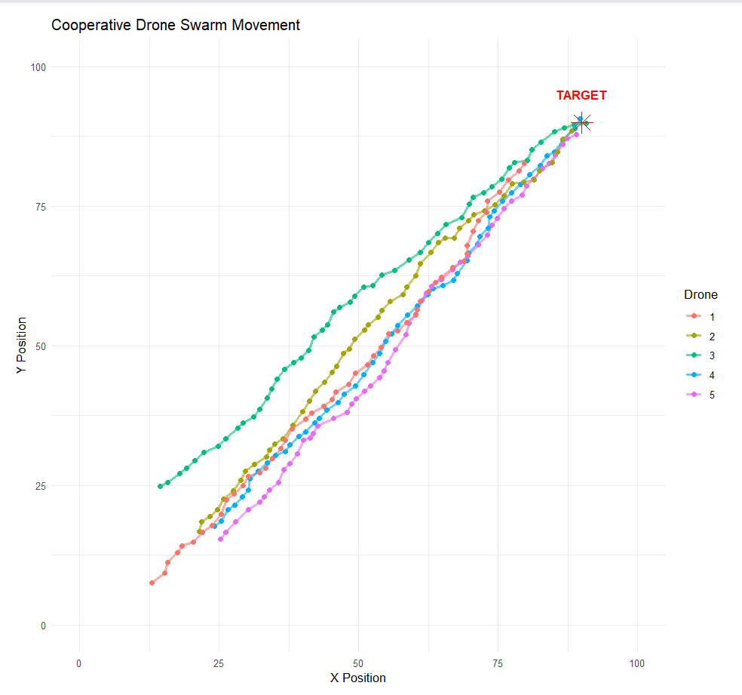
MODULE 2 – Swarm Coordination
Coordinate multiple drones to perform cooperative search.
Apply separation, cohesion, and alignment forces to control swarm movement.
Separation helps maintain safe distance and avoid collisions.
Cohesion keeps drones connected as a coordinated swarm.
Alignment helps drones maintain consistent movement direction.
The combined coordination mechanism enables formation maintenance, collision avoidance, and cooperative exploration.

Slide 16
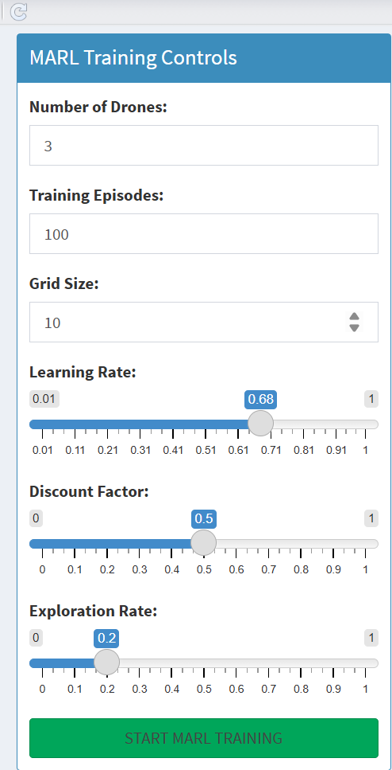
MODULE 3 – Multi-Agent Reinforcement Learning
Each drone acts as an independent learning agent within the swarm.
Drones observe the current state of their environment and neighbouring agents.
Each drone selects an appropriate action for navigation and search.
The selected action produces a reward based on the mission objective.
Q-values are updated using the received reward and next state.
Through repeated interactions, drones learn optimal cooperative search behaviour.

Slide 17
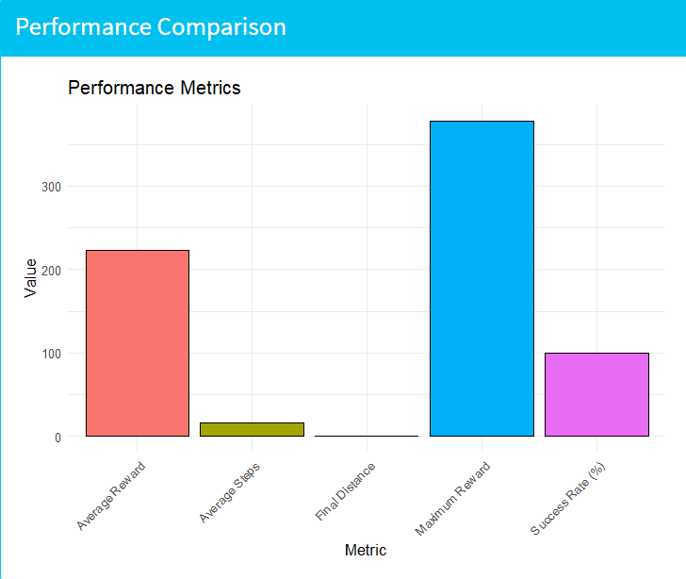
MODULE 4 – Cooperative Reward & Performance Evaluation
Calculate a cooperative reward based on the swarm’s search performance.
Provide positive rewards for increased search coverage and target detection.
Apply penalties for collisions and excessive energy consumption.
Update the drone state and Q-values based on the received reward.
Evaluate the overall mission using Search Coverage and Target Detection Rate.
Repeat the process until the search mission is completed.

Slide 18
RESULT
Performance Evaluation of Cooperative Drone Swarm
Metric | Result / Evaluation
Average Reward | Measures the average cumulative reward obtained during MARL training
Maximum Reward | Represents the highest reward achieved during training
Average Steps | Measures the average number of steps taken by the drones
Final Distance | Measures the average final distance of drones from the target
Success Rate | Percentage of drones that successfully reach the target
The MARL training reward is visualized across episodes to observe learning performance.
Learned drone paths show the navigation behaviour of multiple agents toward the target.
The performance comparison graph presents the calculated evaluation metrics.
The system evaluates the effectiveness of cooperative drone navigation using reward, distance, steps, and success rate.

Slide 19
DISCUSSION
Interpretation of the Proposed System
Category | Project Horizon Implementation
Data Generation | GMM and GAN methods generate the drone dataset.
Preprocessing | Missing values are handled using median replacement, followed by Min-Max or Z-Score scaling.
Swarm Simulation | Multiple drones navigate toward a target using simulated movement and reward-based navigation.
MARL | Independent drone Q-tables learn optimal actions using ε-greedy selection and Q-learning updates.
Learning Performance | Episode rewards are recorded to analyze the learning behaviour of the drone agents.
Performance Evaluation | Average reward, maximum reward, average steps, final distance, and success rate are calculated.
The implementation integrates data generation, preprocessing, swarm simulation, and Q-learning-based MARL into a single workflow. The learned drone paths and reward curves provide visual evidence of agent behaviour, while the performance metrics quantify the effectiveness of the trained swarm.

Slide 20
CONCLUSION
The proposed Project Horizon integrates data generation, preprocessing, drone swarm simulation, and Multi-Agent Reinforcement Learning into a unified framework.
GMM/GAN-based data generation provides synthetic drone operational data for experimentation.
Data preprocessing improves the suitability of generated data for subsequent simulation and learning.
The Q-learning-based MARL module enables multiple drones to learn navigation actions through reward-based interaction.
Learned drone paths and reward curves provide a basis for analyzing swarm learning behaviour.
The final system evaluates performance using average reward, maximum reward, average steps, final distance, and success rate.

Slide 21
FUTURE SCOPE
Extend the system with more advanced Multi-Agent Reinforcement Learning algorithms for improved cooperative decision-making.
Incorporate real-world drone and environmental datasets instead of only synthetic data.
Introduce more complex environments with multiple targets, dynamic obstacles, and larger search areas.
Improve the swarm model with more realistic collision avoidance, communication, and energy constraints.
Deploy the trained model in real-time drone simulation environments for practical search-and-rescue applications.
Compare the proposed approach with other reinforcement learning and swarm intelligence algorithms to evaluate its effectiveness.

Slide 22
REFERENCES
[1] Hickling, T., Hogan, M., Tammam, A., & Aouf, N. (2026). Deep Reinforcement Learning Based Autonomous Decision-Making for Cooperative Uncrewed Aerial Vehicles: A Search and Rescue Real World Application. Journal of Field Robotics.
[2] Chen, C., Yan, S., Zhou, X., et al. (2026). Multi-stage Hierarchical Multi-Agent Reinforcement Learning for UAV-Quadruped Completing Search and Rescue. Discover Robotics.
[3] Liu, M., Wei, J., & Liu, K. (2024). A Two-Stage Target Search and Tracking Method for UAV Based on Deep Reinforcement Learning. Drones.
[4] Sadhu, V., Sun, C., Karimian, A., Tron, R., & Pompili, D. (2024). Aerial-Deep Search: Distributed Multi-Agent Deep Reinforcement Learning for Search Missions. IEEE Conference Proceedings.
[5] Han, S., Liu, X., Zhou, M. C., et al. (2024). Joint Association, Deployment and Flight Trajectory Optimization for Multi-UAV Enabled Large-Scale Mobile Edge Computing. IEEE Internet of Things Journal.
[6] Chung, S. J., Paranjape, A. A., Dames, P., Shen, S., & Kumar, V. (2018). A Survey on Aerial Swarm Robotics. IEEE Robotics and Automation Magazine.

Slide 23
ACKNOWLEDGEMENT
We sincerely thank Dr. Vincent Gnanaraj T, Associate Professor, Department of Quantum Intelligence, SIMATS Engineering, for his valuable guidance and support.
We express our gratitude to SIMATS Engineering for providing the required facilities and academic support.
We thank our faculty members and colleagues for their suggestions and encouragement throughout the project.
We also thank our team members for their cooperation and contribution toward the successful implementation of Project Horizon.

Slide 24
THANK YOU

